Slide 1
TFE3 Xp11.2 translocation RCC mouse model
Laura S. Schmidt
Urologic Oncology Branch
National Cancer Institute, NIH
September 11-13, 2025
Session 4:Shades Beyond Clear: GEM Models of Rare Renal Cell Carcinomas

Slide 2
Why develop a mouse model for TFE3 Xp11.2 tRCC?
TFE3 Xp11.2 tRCC involved in 25-40% of pediatric RCC & 2-5% of adult RCC
Xp11.2 rearrangements create oncogenic fusions with different partners (e.g.PRCC)
TFE3 transcriptionally activates target genes involved in lysosome biogenesis,
autophagy and metabolic pathways that drive tumor progression
TFE3 tRCC is aggressive, can metastasize when small
No effective therapy for advanced disease
NEED A MODEL FOR EVALUATING THERAPIES & MECHANISTIC STUDIES

Slide 3
Generation of PRCC-TFE3/+; KSP-Cre/+ mouse model
Kpn1
LSL-PRCC-TFE3
pROSA26-targeting vector
Short Arm
s.a
PGK-neo-STOP
PRCC-TFE3
pA
Long Arm
DTA
1KB
loxP
loxP
5KB
Electroporate into ES cells
Homologous recombination into ROSA26 locus
Antibiotic selection
s.a
PGK-neo-STOP
PRCC-TFE3
pA
Targeted ROSA26 locus
in ES cell
loxP
loxP
Blastocyst injection -> chimeras
Backcross for germline transmission
X
KSP(cadherin16)-Cre/+
Lox-STOP-Lox-PRCC-TFE3/+
PRCC-TFE3/+; KSP-Cre/+ mice
PRCC-TFE3 expression in the distal nephron

Slide 4
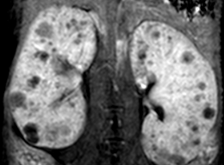
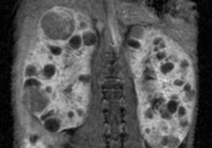
Phenotype of PRCC-TFE3/+; KSP-Cre/+ mice
Multiple bilateral tumors and cysts are visible on imaging by 4 months of age
MRI with contrast of mouse at 7 (left)and 9 months(right) of age
Tumors and cysts display rapid growth rate (~3-fold increase in size)

Slide 5
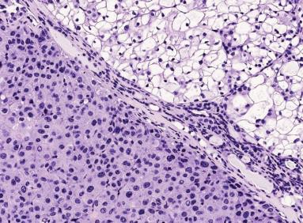
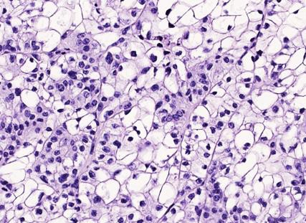
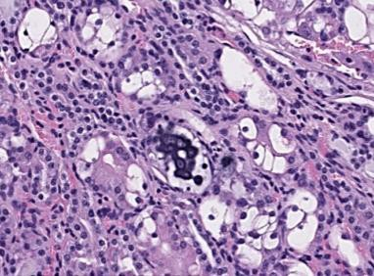
Histology of PRCC-TFE3/+; KSP-Cre/+ kidney tumors
N
N
T
T
200µm
100µm
100µm
cells with eosinophilic cytoplasm cells with large clear cytoplasm calcified psammoma body

Slide 6
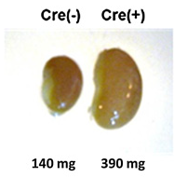
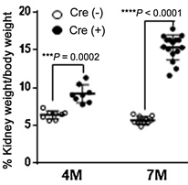
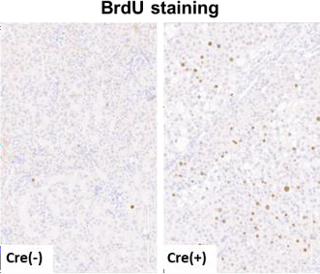
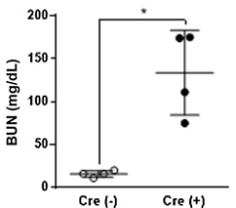
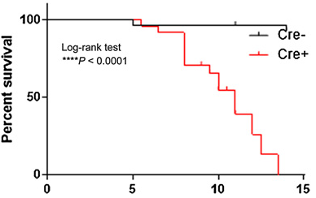
Characterization of PRCC-TFE3/+; KSP-Cre/+ mice
PRCC-TFE3/+;KSP-Cre/+ kidneys 2-3 fold heavier than littermate controls
Shortened lifespan due to kidney failure (median 11 mo.)

Slide 7
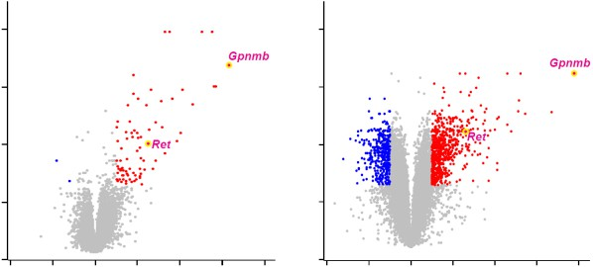
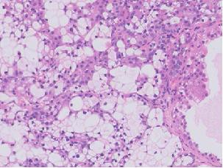
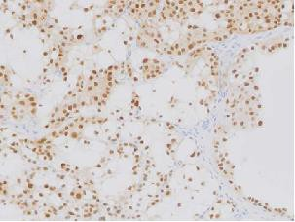
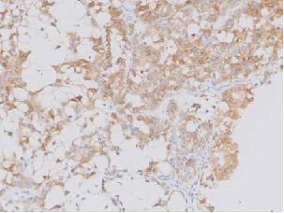
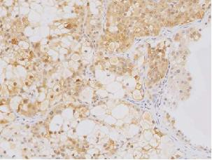
Gene expression analysis of PRCC-TFE3/+; KSP-Cre/+ kidneys
identifies Tfe3 target Gpnmb and Ret proto-oncogene
4 mo. kidneys
7 mo. kidneys
Gpnmb Ret
p=0.0239 p=0.0006
8
8
3000
60
6
6
-Log₁₀(q-value)
4
2000
40
4
Relative expression
Relative expression
2
2
1000
20
0
0
0
0
-4 -2 0 2 4 6 8
-4 -2 0 2 4 6 8
Cre(-)
Cre(+)
Cre(-)
Cre(+)
Log2(Cre+/Cre-)
Log2(Cre+/Cre-)
Gene expression volcano plots display
significantly expressed genes
qPCR confirms Gpnmb & Ret
H&E Tfe3 Gpnmb Ret
50µm
Nuclear Tfe3, Gpnmb and Ret protein expression in PRCC-TFE3/+;KSP-Cre+ kidneys by IHC

Slide 8
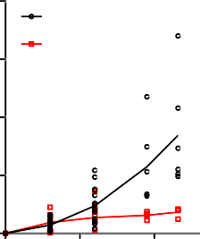
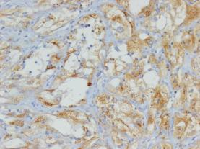
PRCC-TFE3/+; KSP-Cre/+ tumor response to
RET/VEGFR inhibitor vandetanib (100mg/kg)
1.0
Vehicle
800
Vehicle
Vandetanib
T1
T2
T3
0.8
600
p<0.0001
0.6
400
Tumor diameter (cm)
% Tumor growth
0.4
0.2
200
0.0
0
0 50 100 day
0 50 100 day
1.0
Vandetanib
T1
0.8
T2
T3
0.6
T4
Tumor diameter (cm)
0.4
0.2
50µm
0.0
0 50 100 day
RET IHC on human TFE3-tRCC

Slide 9
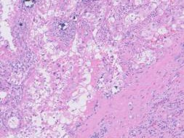
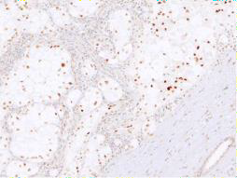
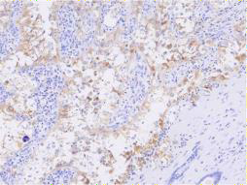
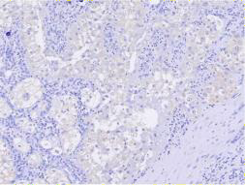
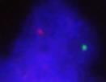
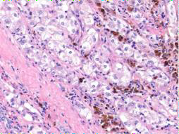
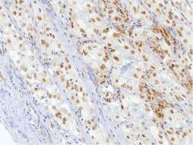
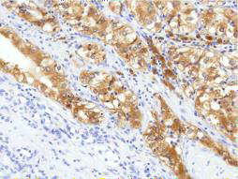
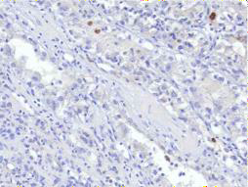

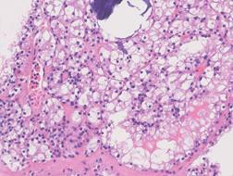
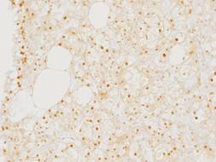
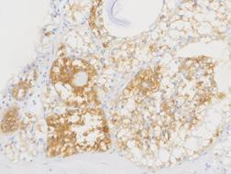
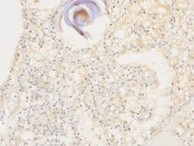

GPNMB, an improved diagnostic marker of TFE3 tRCC
H&E
TFE3
GPNMB
Cathepsin K
a
b
c
d
Case 1 Male ASPL-TFE3
100µm
e
f
g
h
Case 4 Female
PRCC-TFE3
50µm
i
j
k
l
Case 8 Female SFPQ-TFE3
50µm

Slide 10





GPNMB, an improved diagnostic marker of TFE3 tRCC
KIRP
KIRC
p < 0 .0 0 0 1
n . s .
p < 0 .0 0 0 1
n . s .
GPNMB
B-actin
20
p<0.0001
n.s.
2 0
p < 0 .0 0 0 1
n . s .
relative expression
15
1 5
10
1 0
UOK120
UOK146
UOK124
UOK109
UOK111
UOK115
UOK140
5
5
0
0
Total-pRCC
Type1-pRCC
Type2-pRCC
TFE3-RCC
Total-pRCC
Type1-pRCC
Type2-pRCC
TFE3-RCC
ccRCC TFE3-RCC
GPNMB
ccRCC TFE3-RCC
Xp11.2 tRCC
ccRCC
CTSK
GPNMB
CTSK
GPNMB is expressed in
TFE3 tRCC cell lines,
but not in ccRCC lines
GPNMB is expressed inTFE3 tRCC but not ccRCC or pRCC
(TCGA data) whereas CTSK shows no significant difference

Slide 11
Acknowledgements
Linehan Lab, UOB, NCI
Masaya Baba
Martin Lang
Hisashi Hasumi
Yukiko Hasumi
Ying Huang
Laura Schmidt
Marston Linehan
Collaborators
Mitsuko Furuya
Takanobu Motoshima
Shintaro Funasaki
And others
Frederick National Lab Core Facilities
Small Animal Imaging
Joseph Kalen
Lily Ileva
Molecular Histology Lab
Baktiar Karim
Lab of Animal Sciences
Nicole Morris

