Slide 1
Somatic Mouse Models in Kidney Cancer
A Ari Hakimi MD
Associate Professor, Co-Leader Translational Kidney Cancer Program
Department of Surgery, Urology Service
MSKCC
September 11-13, 2025
Session #:Topic

Slide 2
Why Somatic/Syngeneic Models
Genetically engineered mouse models (GEMMs) are valuable for genotype–phenotype relationships and for evaluating new therapeutic concepts in a range of tumor types, however:
  Germline intercrossing is resource-intensive, limiting modeling of tumor genotypes and large-scale studies
  Modeling tumor–host genetics requires excessive intercrosses, making it cumbersome and inefficient
  Long latency for tumors formation
  Cystic renal disease limits outcomes assessment
  Lack of metastatic models
Patient Derived xenograft, can better reflect humans tumor complexity but:
  Lack of immune system: PDXs require immunodeficient mice, preventing interrogation of immune–tumor interactions and limiting immunotherapy studies.
  Engraftment bias: Not all patient tumors successfully engraft; more aggressive subtypes are overrepresented, skewing results.
  Time and cost: Establishing and expanding PDX lines is slow and resource-intensive, delaying preclinical testing.
  Genetic drift: Over passages, PDXs can accumulate mouse-specific adaptations or diverge from the patient’s original tumor.
  Stroma replacement: Human stromal components are gradually replaced by murine stroma, altering the tumor microenvironment.
  Limited scalability: Difficult to model large patient cohorts or perform high-throughput studies due to cost and engraftment variability.
  Logistical hurdles: Reliance on fresh patient tissue and immunodeficient animals increases complexity.

Slide 3
Feature | PDX (Patient-Derived Xenograft) | GEMM (Genetically Engineered Mouse Model) | Syngeneic or Somatic Model
Pros | • Retain human tumor genetics & heterogeneity • Clinically relevant, patient-derived • Useful for targeted therapy testing • Captures intra-/inter-tumor variability | • Tumors arise de novo in immunocompetent host • Models natural initiation & progression • Compatible with immune studies (incl. immunotherapy) • Highly reproducible & scalable | • Fully immunocompetent host (intact immune system) • Rapid, inexpensive, and reproducible • Widely used for immunotherapy testing • Scalable for large cohorts/high-throughput
Cons | • Require immunodeficient mice (no immune studies) • Engraftment bias toward aggressive tumors • Time-consuming & costly • Human stroma replaced by mouse stroma • Genetic drift over passages • Limited scalability | • Time/resource-intensive breeding & crosses • Limited tumor genotype spectrum • Less human-relevant heterogeneity • May not capture late-stage/metastatic disease | • Tumors are murine, not human (limited clinical relevance) • Do not reflect patient tumor heterogeneity • Faster growth kinetics than human cancers • Limited translational predictive value
Best Used For | • Testing targeted therapies • Capturing patient heterogeneity • Translational drug development | • Mechanistic studies of tumor initiation • Genetics-driven hypotheses • Immunocompetent modeling | • Immunotherapy screening • Rapid, scalable preclinical studies • Cost-effective high-throughput testing

Slide 4
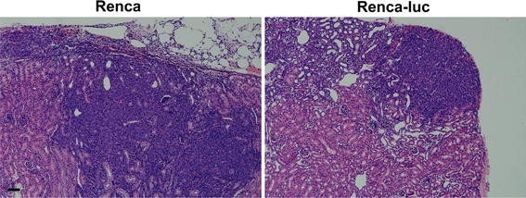
RENCA Syngeneic Model in Kidney Cancer
Origin:
  Derived in 1973 from a spontaneous renal cortical adenocarcinoma in BALB/c mouse.
  Maintained as a transplantable murine cell line.
  Histology resembles poorly differentiated renal carcinoma.
Uses:
  Widely used in preclinical immuno-oncology (checkpoint inhibitors, vaccines, adoptive T cells).
  Metastasis models: subQ (local growth), orthotopic (kidney + metastasis), IV/intracardiac (experimental metastasis).
  Drug testing platform for chemotherapy, targeted therapy, and immunotherapy.
  Studying angiogenesis, tumor–immune interactions, microenvironment.
Problems:
  Murine origin – lacks human RCC genetics (no VHL/HIF alterations).
  Aggressive growth kinetics, less clinically relevant timelines.
  Histology does not fully mimic human clear cell RCC.
  Limited translational predictability – effective preclinical therapies often fail clinically.
  Restricted to BALB/c strain.

Slide 5
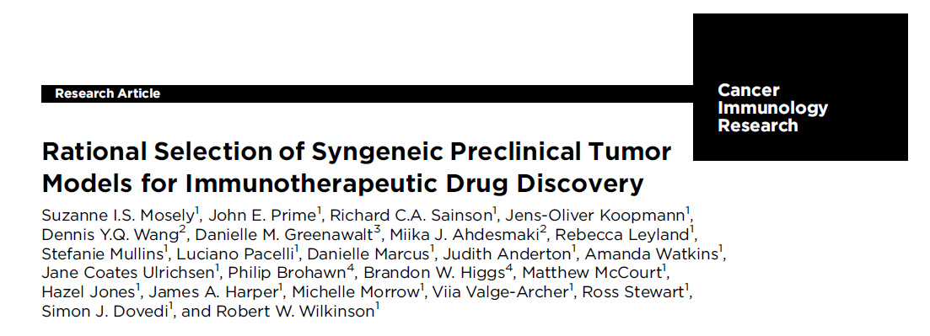
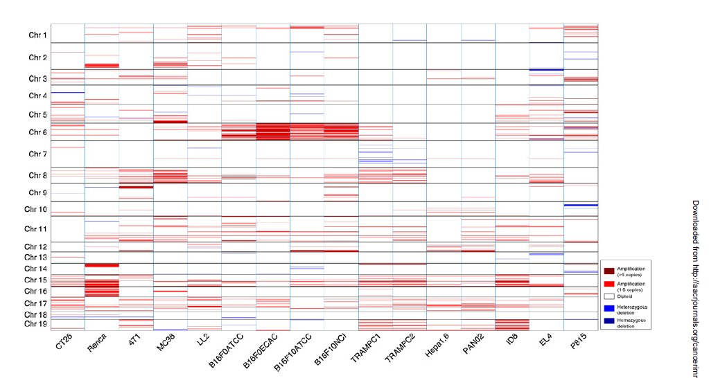
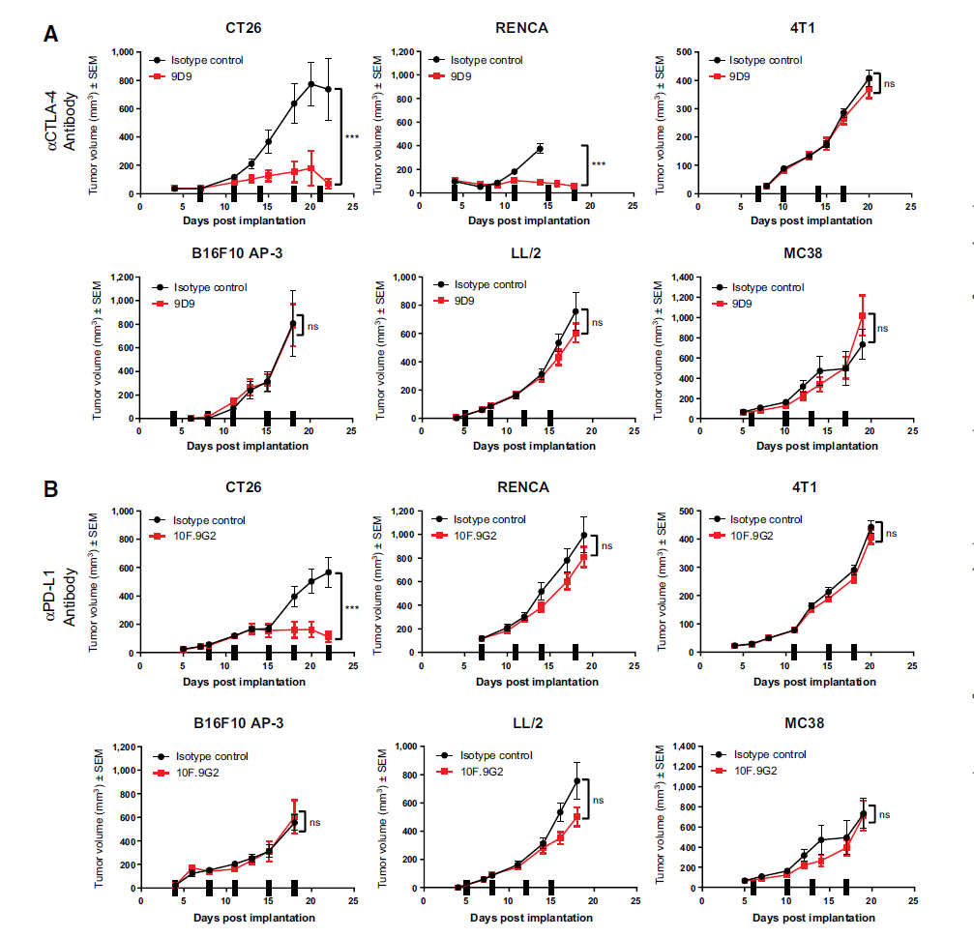
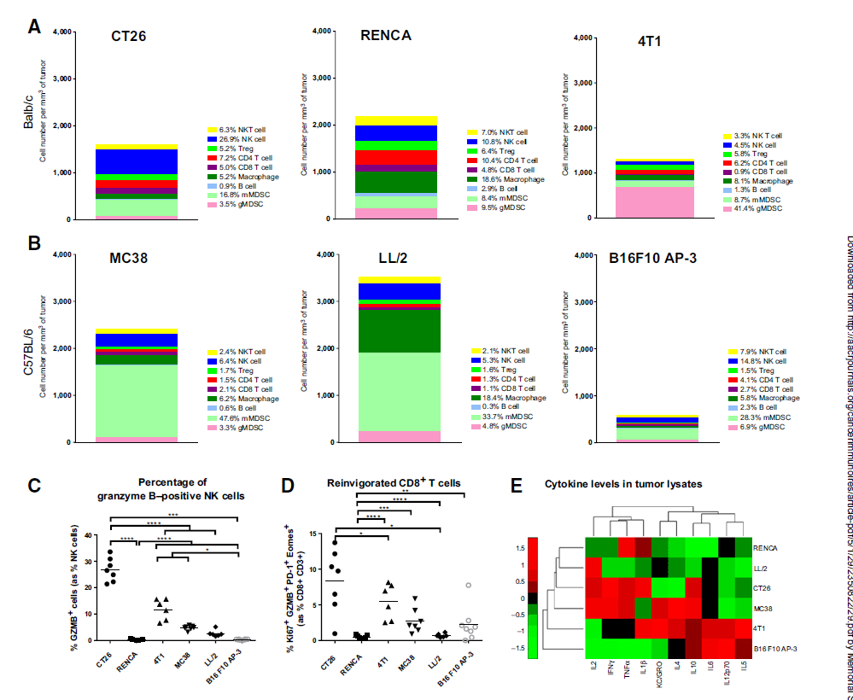

Slide 6
Techniques for somatic models
Tumor Cell Line Derivation
  Source: Tumors are induced in mice (chemically, virally, or genetically) and tumor cells are harvested to establish murine cancer cell lines.
  In vivo editing
  Ex vivo editing
  Key Point: Once established, these lines can be propagated indefinitely and used across experiments.

Slide 7
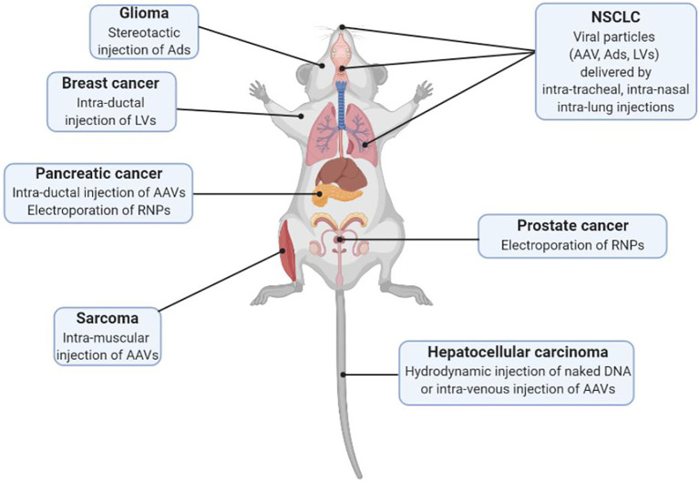

Slide 8
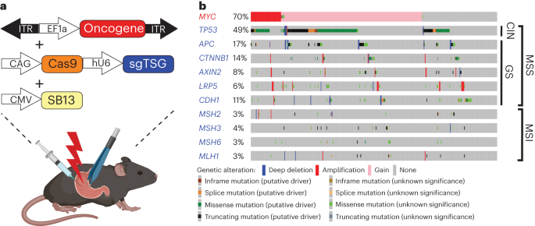
Ex-vivo engineering
Genetically Defined Murine Tumors Transplanted
  Tumor cells can be engineered ex vivo (e.g., CRISPR/Cas9, shRNA, transposon) to introduce specific oncogenes or delete tumor suppressors.
  Modified tumor cells are then transplanted into syngeneic hosts.
  Advantage: Models specific driver mutations in an immunocompetent setting.
Leibold et al Nat Cancer 2024

Slide 9
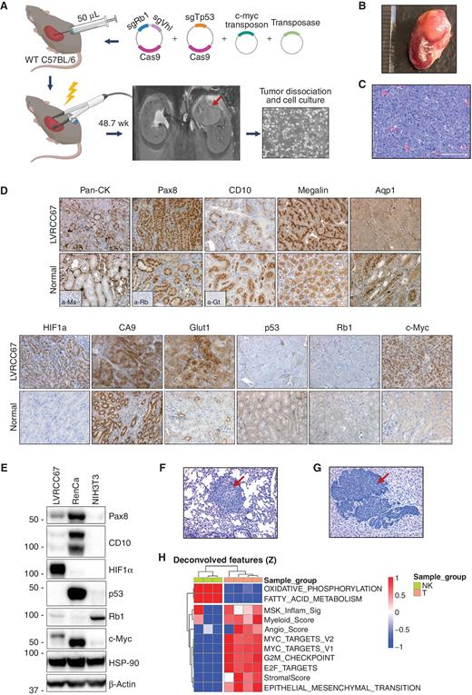
LVRCC
Rappold, Voung et al Canc Disc 2022

Slide 10
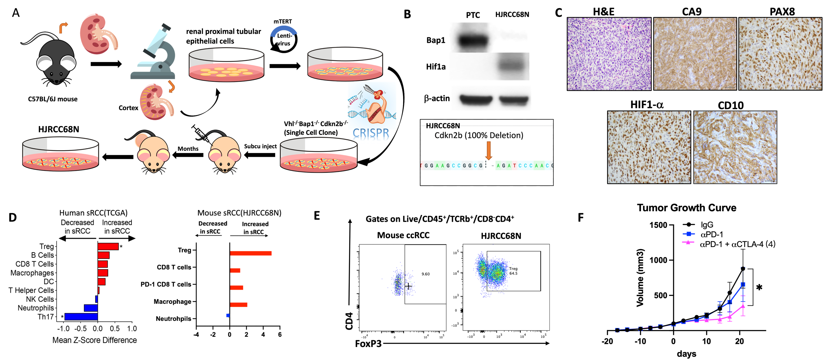
Editing cell of origin ev-vivo
Hui et al Unpublished

Slide 11
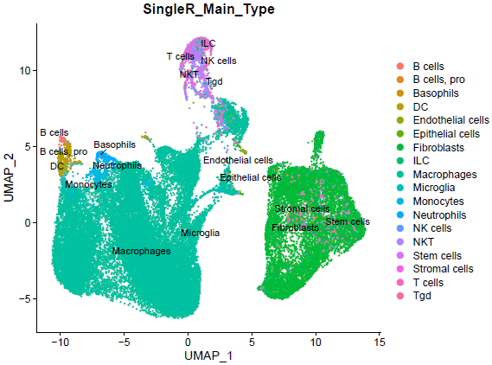
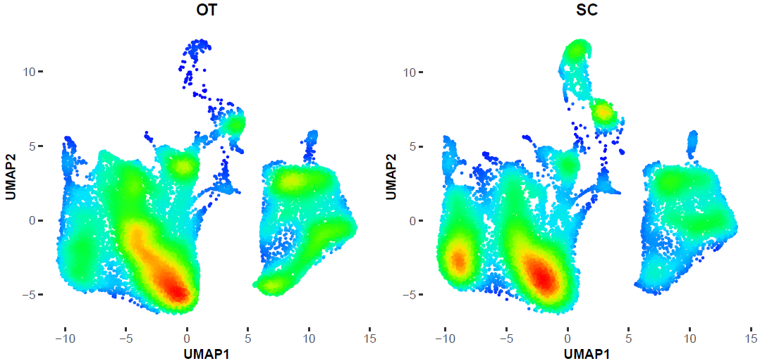
Location of implantation can impact TME

Slide 12
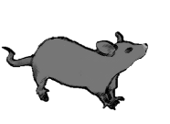

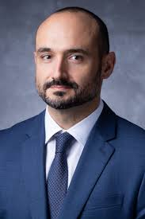
Generation of somatic mosaic models of RCC
EX1
Cre
pA
EX2
Pax8^{Cre}
Pax8^{Cre/+}
H11^{LSL-Cas9/+}
R26^{RCFL-TdT/+}
LoxP
LoxP
H11^{LSL-Cas9}
CAG
STOP
Cas9
LoxP
Frt
R26^{RCFL-TdT}
LoxP
Frt
CAG
STOP
STOP
TdT
+ CRE
LoxP
AAV-sgRNAs
ITR
AttB1
AttB2
CAGG
Flpo
pA
ITR
CAG
Cas9
LoxP
LoxP
L2272
L2272
Frt
Frt
sgRNA 1
sgRNA 2
LoxP
CAG
STOP
TdT
U6
U6
+ CRE
+ FLPO
LoxP
AAV-sgRNAs
CAG
Cas9
ITR
AttB1
AttB2
CAGG
Flpo
pA
ITR
LoxP
L2272
Frt
sgRNA 1
sgRNA 2
LoxP
U6
U6
CAG
TdT

Slide 13
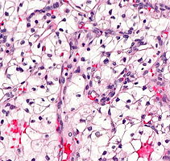
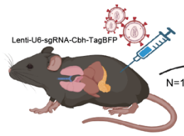
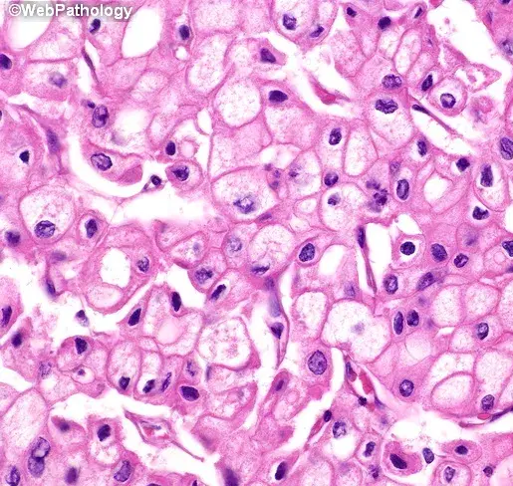
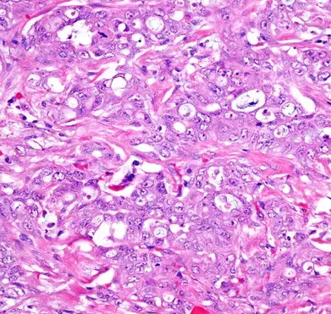
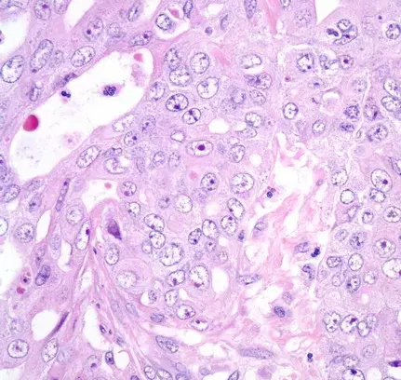
RCC subtypes by pathology/genetics
Vhl^{KO}-Setd2^{KO}-Cdkn2a/b^{KO}
Vhl^{KO}-Bap1^{KO}-Cdkn2a/b^{KO}
Vhl^{KO}-Tp53^{KO}-Pten^{KO}
Tp53^{KO}-Pten^{KO}
Nf2^{KO}-Setd2^{KO}-Cdkn2a/b^{KO}
Nf2^{KO}-Bap1^{KO}-Cdkn2a/b^{KO}
Nf2^{KO}-Tp53^{KO}-Cdkn2a/b^{KO}
Fh^{KO}-Cdkn2a/b^{KO}
Pax8^{Cre/+}
H11^{LSL-Cas9/+}
R26^{RCFL-TdT/+}
Smarcb1^{KO}-Tp53^{KO}-Cdkn2a/b^{KO}
Notes:
In yellow cell lines available

Slide 14
Conclusion
Somatic mouse models offer flexible options for rapid drug testing
Allow for immunocompetent studies enabling assessment of TME
Can be customized by genotypes
Are limited by mouse genetics and inherent differences in human/mouse immunity

